Slide 1
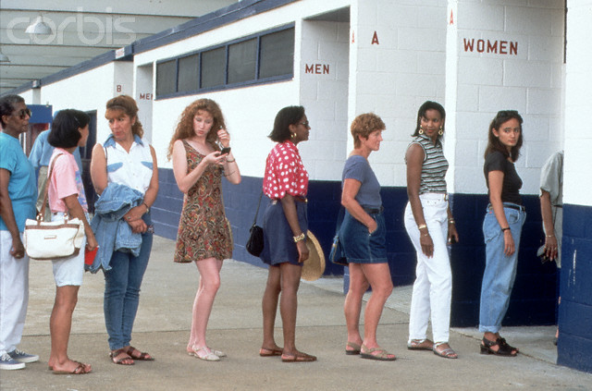
Queueing Theory gets a Makeover
Mor Harchol-Balter
Carnegie Mellon University
Computer Science
Notes:
I’m in the CS dept at CMU, but I work on LIDS-type research. I did my postdoc here at MIT.
I work in the area of q-theory, which is the study of queues.
For example, I spend a lot of time wondering why there’s always a line at the women’s restroom and never at the men’s.
You know, the Economist did a study on this a few years ago, and found that women spend twice as long in the restroom as men (probably all that hand-washing …). So you might think that if you double the number of women’s rooms then delays become equal. But as a q-theorist, I know that even doubling is not actually enough …
Anyway, let’s look at some traditional queueing models.

Slide 2
Traditional Queueing Models
“Job” occupies ONE server only
JSQ
Notes:
This is the simplest model. Think of this as a CPU run queue, or a queue at a router. Jobs queue up and are served here by the server.
This is the bank model. There are many servers. Job goes to whatever server frees up first.
This last model is a supermarket model or a load balancer in data center. There are many separate queues, each with their own server. When customer or job walks up it might choose to Join Shorest Queue.
One thing that all these traditional queueing models have in common is that a job or customer occupies exactly ONE server.
Lead in: You might wonder why we have queues. Most people think queueing occurs because there’s high load (more arrivals than departures). But many companies I talk to complain that their load is low and yet they still have high queueing times. The reason for the high queueing times is variability in the job sizes (mixing up small jobs with large ones, which means that small jobs end up waiting behind large ones). It turns out that in computer workloads, this variability can be quite high.

Slide 3
Why we wait
Today’s Computing Workloads
Probability
job size > x
1) Huge range of job sizes
2) Extremely heavy tail
1.0
$$C^{2}>1000$$
20%
$$≫$$
0.1
Top 20% jobs = 80% cpu
0.01
top 20%
of jobs
0.001
1.0
100
x cpu-hours
0.01
10000
0.0001
1000000
* Numbers on x axis are for illustration purposes only.
Notes:
I do work with a lot of companies, and here’s the type of distribution that I tend to see.
What I’m showing you here is … Notice this is on a log-log scale. Don’t pay attention to individual numbers on x axis, which are arbitrary and just for illustration.
There are 2 things to notice here, and both explain the reason why we wait:
80/20 often touted but not true
1%/50% – wealth in the country – also my PhD thesis.
Truth 1%/97%.
Implications: These hogs are starving out the other 99% of jobs. Causing huge waits. Must get the hogs out of the way. Much of the research in LIDS is about getting hogs out of the way.

Slide 4
Why we wait
Today’s Computing Workloads
Probability
job size > x
1) Huge range of job sizes
2) Extremely heavy tail
1.0
$$C^{2}>1000$$
$$≫$$
0.1
Top 20% jobs = 80% cpu
Top 1% jobs = 97% cpu
0.01
top
1%
0.001
1.0
100
x cpu-hours
0.01
10000
0.0001
1000000
* Numbers on x axis are for illustration purposes only.
Notes:
I do work with a lot of companies, and here’s the type of distribution that I tend to see.
What I’m showing you here is … Notice this is on a log-log scale.
There are 2 things to notice here, and both explain the reason why we wait:
80/20 often touted but not true
Truth 1/97.
Let me try to put this in a way that everyone can relate to. You all graduated from MIT, so you’re probably in the top 1% of wage earners. So now imagine that the people earning in the top 1% control 97% of the total money. That’s pretty stunning. Anyway, the fact that the 1% biggest jobs comprise 97% of cpu usage has huge implications for scheduling. These hogs are starving out the other 99% of jobs. Causing huge waits. Must get the hogs out of the way. Much of the research in LIDS is about getting hogs out of the way.

Slide 5
Traditional Queueing Models
“Job” occupies ONE server only
Better Dispatching
to combat job size variability
(separate shorts from longs)
Better Scheduling
to combat job size variability
(shortest job first)
JSQ
Notes:
For instance much research is driven by finding better scheduling policies to combat this job size variability, like letting the short jobs run ahead of the long ones. Also, there’s a ton of research on better dispatching to combat job size variability by creating separate queues for short jobs and long ones, just like in the supermarket.
Lead in to next slide: We have been studying these models for a long time and have a good idea of what to do and how to analyze delays. But we’re still in the traditional model here where each job occupies ONE server only.

Slide 6
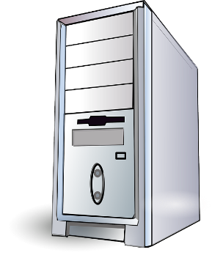
But that’s all in the past …
Today’s world is PARALLEL
10,000 servers
16 cores
4 cores
2 cores
and today’s jobs occupy
MULTIPLE servers.
Notes:
Today’s world is way more complicated.

Slide 7
NEW Queueing Models
“Job” occupies MANY servers
Even more complex when
individual tasks
take different times.
Open problem: Understanding delays in this setting.

Slide 8
NEW Queueing Models
“Job” occupies MANY servers
Compute
resources
Memory
resources
Open problem: Understanding delays in this setting.

Slide 9
Malleable Jobs add Complexity
“Job” is flexible in number of servers it needs
Speedup
s(k)
“perfect”
6
5
4
reality
3
2
1
1
2
3
4
5
6
# servers, k

Slide 10
Malleable Jobs add Complexity
“Job” is flexible in number of servers it needs
Speedup
s(k)
“perfect”
6
5
4
reality
3
2
1
1
2
3
4
5
6
# servers, k
Open problem: Optimally allocating servers among
jobs, and determining delays.

Slide 11
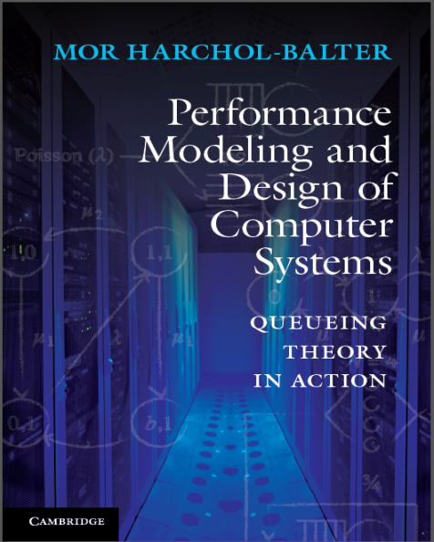
Summary
It’s a parallel world …
with lots of exciting new queueing
problems to solve!
Compute
Memory

